Slide 1


Towards NLP-Based Real-Time Assistance to Human Therapist
Zixiu “Alex” Wu
Feb 2023

Slide 2
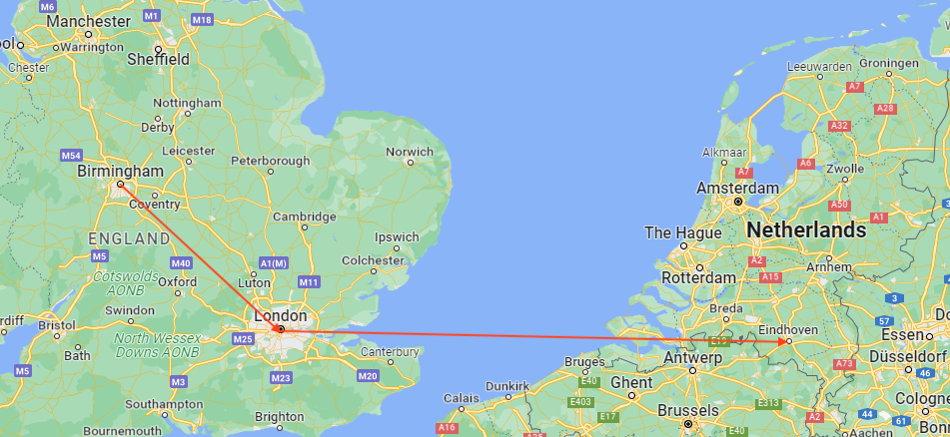
About Me
Final-year Marie-Curie industrial PhD candidate @ Philips Research (NL) (2020-)
NLP for healthcare
Conversational AI
NLG & Evaluation
MSc Advanced Computing @ Imperial College London (2019)
(Multimodal) Machine Translation
BSc Computer Science @ University of Birmingham (2018)

Slide 3
Outline
Creating counselling dialogue dataset: AnnoMI (ICASSP 2022)
Suggesting next-turn dialogue action for therapist (Interspeech 2022)
Generating next-turn response for therapist & Its evaluation (GEM@EMNLP 2022)
Outlook: How large language models (LLMs) can be conducive to NLP-based real-time assistance

Slide 4
Part 1/4 Creating counselling dialogue dataset: AnnoMI
Anno-MI: A Dataset of Expert-Annotated Counselling Dialogues (ICASSP 2022)

Slide 5



Background: Motivational Interviewing
Motivational Interviewing (MI)
An important technique of psychotherapy aimed at evoking client’s own motivation for positive behaviour change, e.g. smoking cessation, drinking reduction, …
Commonly used in healthcare settings where behaviour change contributes to improved health
MI Dialogue: 2-person conversation between therapist & client
MI Principles (RULE):
R: Resist the righting reflex
U: Understand your patient’s motivations
L: Listen to your patient
E: Empower your patient
Photo: https://stock.adobe.com/
$utterance
$utterance
…
$utterance
$utterance

Slide 6
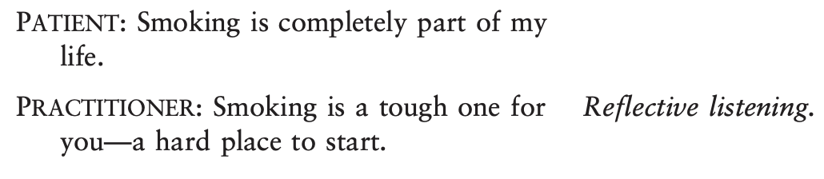
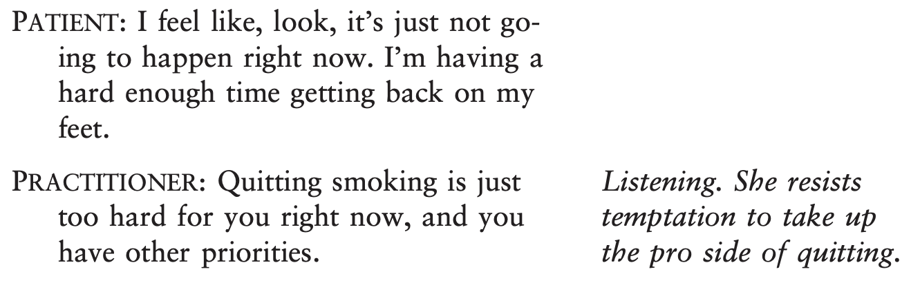
Background: Motivational Interviewing
Case Study (Rollnick et al. 2008)
Goal: Encouraging patient in cardiovascular rehabilitation to adopt behaviours conducive to rehabilitation, e.g., smoking less & exercising more.
MI Principles:
R: Resist the righting reflex
U: Understand your patient’s motivations
L: Listen to your patient (reflective listening, a.k.a. reflection)
E: Empower your patient

Slide 7
Therapy Dialogues are Extremely Low-Resource
Reason: privacy & legal constraints
Status quo:
Mostly privately owned
Only one publicly & freely available MI dataset (Perez-Rosas et al. 2019)
Automatically transcribed therapy demonstration videos -> Noise & wrong interlocutor labels
No annotations
Photo: https://stock.adobe.com/

Slide 8

AnnoMI: Legal, Well-Transcribed, Expert-Annotated
Data: expert-annotated transcripts of professionally produced therapy demonstration videos
One-to-one dialogues between therapist and client
A wide range of topics, e.g., smoking cessation, alcohol use reduction, etc.
Unambiguously Legal
Obtained explicit consent from video owners for dataset creation & release
Well-Transcribed
Manually transcribed by professional transcription service
Expert-Annotated
Annotators: professional therapists found through Motivational Interviewing Network of Trainers (MINT)
Photo: https://stock.adobe.com/
image source: https://motivationalinterviewing.org/sites/default/files/mint_0.jpg

Slide 9

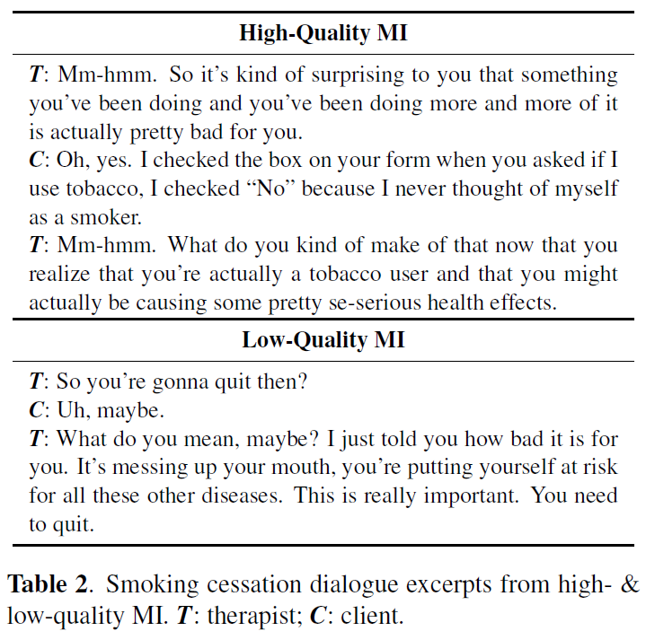
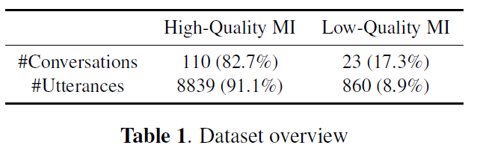
AnnoMI: Source Material & Consent
Videos on YouTube/Vimeo demonstrating high- and low-quality motivational interviewing (MI)
Keyword search, e.g., “effective motivational interviewing”, “bad MI”, …
High-quality MI: client-centred & empathetic
Low-quality MI: mostly provides instructions & suggestions
Reflective of real-world counselling: demonstration videos from professional therapists & established institutions
Also alleviates privacy concerns
Explicit consent from video owners for dataset creation & release
No unauthorised scraping!

Slide 10
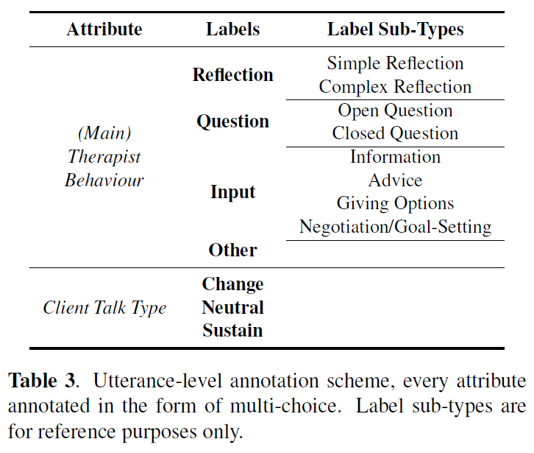
AnnoMI: Expert Annotations
Utterance-level annotations by experts
Scheme based on counselling literature & therapist input
Therapist utterance labels: Actions/Behaviours
Reflection – to show active listening
Question
Input
Other (e.g., “Hmm”, “OK”, greetings), where none of the above appears

Slide 11
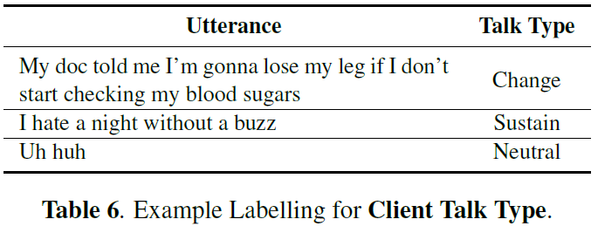
AnnoMI: Expert Annotations
Utterance-level annotations by experts
Scheme based on counselling literature & therapist input
Client utterance labels: Talk types
Change talk – leaning towards behaviour change
Sustain talk – showing resistance to change
Neutral talk – no particular inclination

Slide 12
AnnoMI: Expert Annotations
Utterance-level annotations by experts
Scheme based on counselling literature & therapist input
10 transcripts out of 133 used for inter-annotator agreement
Annotated by every expert
Substantial agreement for therapist utterance labels, moderate for client ones

Slide 13
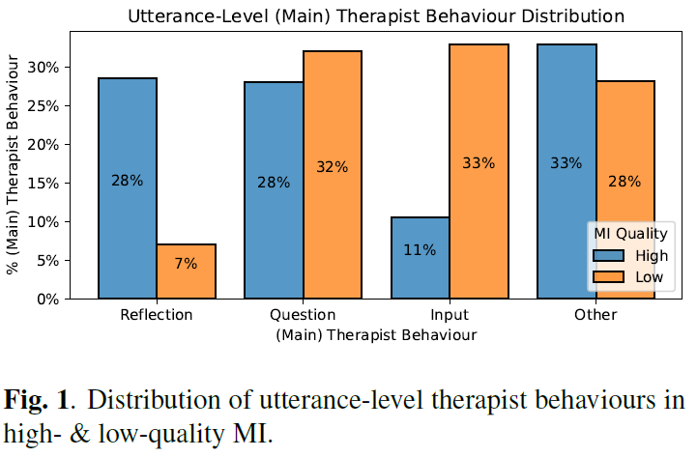
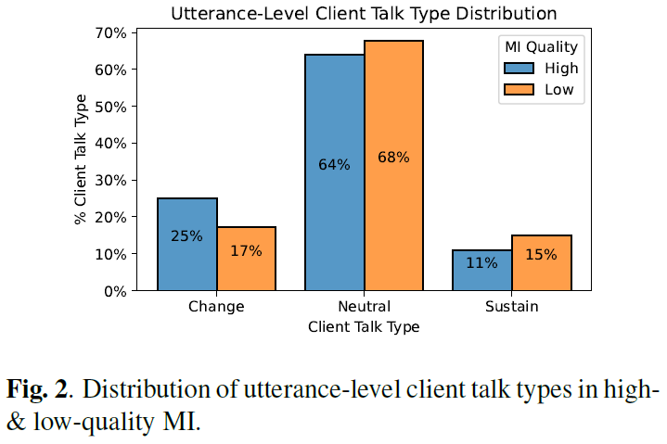
AnnoMI: Overall Label Distribution
Therapist in high-quality MI listens & tries to understand client to a substantially larger extent
Reflection: high-quality (28%) > low-quality (7%)
Input: high-quality (11%) < low-quality (33%)
Client is more willing to change in high-quality MI and shows less resistance in low-quality MI
Change talk: high-quality (25%) > low-quality (17%)
Sustain talk: high-quality (11%) < low-quality (15%)
In line with general observations of real-world high- & low-quality MI

Slide 14
Applications: Coaching & Guidance for (Junior) Therapists
Forecasting next-turn therapist action, given dialogue history so far (part 2/4)
Generating potential next-turn therapist response (part 3/4)
Photo: https://stock.adobe.com/

Slide 15
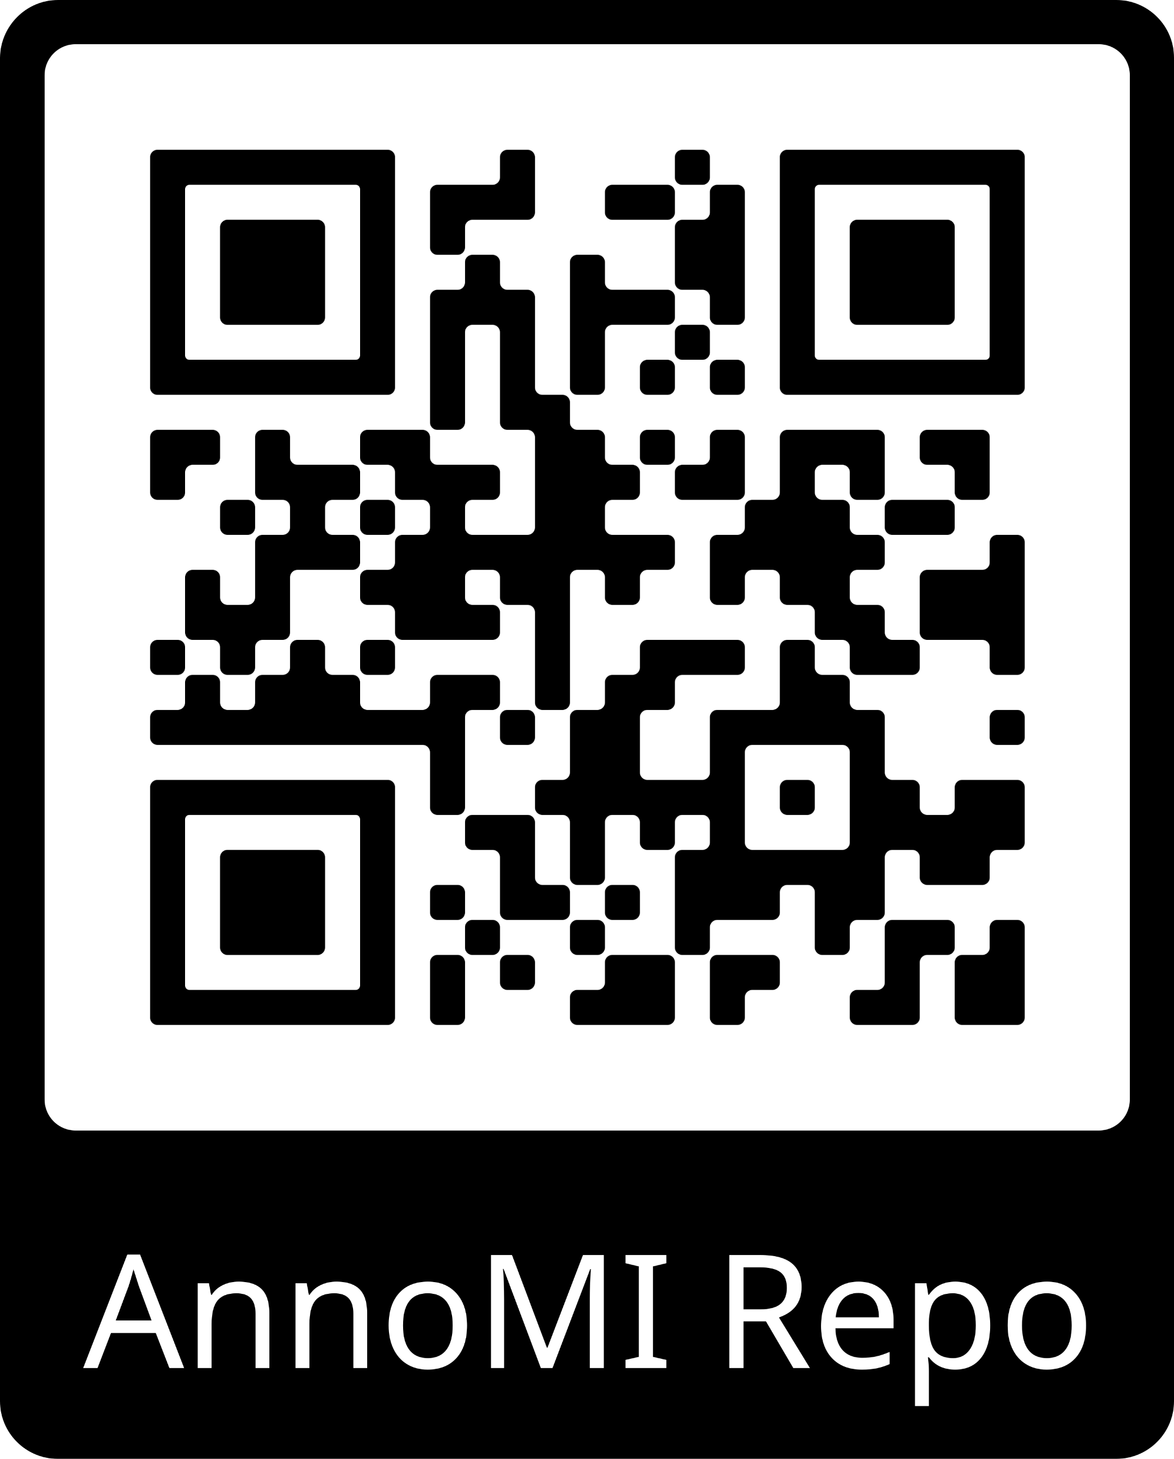
AnnoMI Takeaways
First publicly & freely available dataset of faithfully transcribed and expert-annotated therapy dialogues
Real-life like dialogues demonstrate both high- & low-quality counselling
Applicable in NLU & NLG use cases for coaching/guiding therapists
Photo: https://stock.adobe.com/

Slide 16
Part 2/4 Suggesting next-turn dialogue action for therapist
Towards Automated Counselling Decision-Making: Remarks on Therapist Action Forecasting on the AnnoMI Dataset (INTERSPEECH 2022)

Slide 17
Task: Next-Turn Therapist Action Forecasting
Forecasting the action of the next-turn therapist utterance, given the N preceding utterances (a.k.a. dialogue history/context)
Previous work: Cao et al. (2019) using RNNs & undisclosed MI dialogues annotated differently; No modelling choices examined except for dialogue history length
Application: Good forecaster would be useful for real-time action suggestion for therapist
Our contribution: We explore larger language models + various modelling choices, incl.
Varying dialogue history length
Data augmentation
Inserting therapist & client utterance labels in dialogue history
Contrasting therapist actions in high- & low-quality MI
$utterance
$utterance
…
$utterance
$utterance
Therapist Action Forecaster
$action

Slide 18
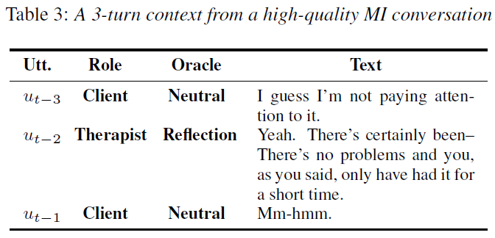
Basic Setup
Input Format: Concatenating utterances with inserted interlocutor labels and utterance separators
“⟨client⟩I guess I’m not paying attention to it.|⟨therapist⟩Yeah.
There’s certainly been– There’s no problems and you, as you
said, only have had it for a short time.|⟨client⟩Mm-hmm.”
5-fold cross validation
Test on high-quality MI dialogues only
Task is to forecast “what a good therapist would do next”

Slide 19
Modelling Choices (pt. 1/3)
Varying dialogue history length
Length options
1, 3, 5, 7, 9 previous utterances in dialogue history, or
Max: As many utterances as model can fit -> 512 tokens with left truncation to preserve temporally most recent utterances
Every other modelling choice is combined with different history lengths for deeper insights
Data augmentation: neural utterance paraphrasing -> 5x training data volume

Slide 20
Modelling Choices (pt. 2/3)
Inserting Utterance Labels in Context
Utterance Labels: therapist actions for therapist utterances, talk types for client utterances
Interlocutor utterance labels to add:
Therapist utterance labels only
Client utterance labels only
Therapist & client utterance labels
Utterance label sources:
Oracle (ground truth)
Predicted
LM-based, input = single-turn utterance only
0.78 Macro F1 for therapist utterances, 0.53 for client utterances
Random
Example below: Therapist & client utterance labels x Oracle
“⟨client⟩~<neutral>I guess I’m not paying attention to it.|⟨therapist⟩~<reflection>Yeah. There’s certainly been– There’s no problems and you, as you said, only have had it for a short time.|⟨client⟩~<neutral>Mm-hmm.”

Slide 21
Modelling Choices (pt. 3/3)
Contrasting High- & Low-quality MI using plain-text MI quality labels
“[high][SEP]⟨client⟩I guess I’m not paying attention to it.|⟨therapist⟩Yeah. There’s certainly been– There’s no problems and you, as you said, only have had it for a short time.|⟨client⟩Mm-hmm.”
Train on high- & low-quality, test on high-quality only
Motivation: contrast learning may improve action-forecasting model’s decision boundaries
2 variants of contrast:
Unbalanced: original unbalanced high- & low-quality (10:1) MI dialogue contexts
Aug-Balanced: augment low-quality MI dialogues using neural paraphrasing

Slide 22
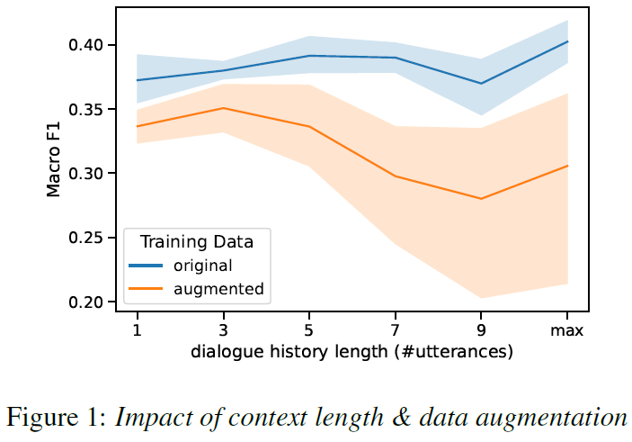
Experiments & Results (pt. 1/3)
All experiments done with roberta-base & 5-fold cross validation
roberta-large had consistently lower performance in preliminary study
Impact of history length & data augmentation
Low performance overall (<= 0.4 Macro F1)
Most likely linked to therapists’ freedom in choosing their next action
Augmentation generally hurts performance
Possibly due to altered semantics in paraphrases
Longer dialogue history -> more paraphrases in input -> more semantic alteration -> worsened performance gap with baseline
Line: Mean; Error band: 95% confidence interval (cross validation)

Slide 23
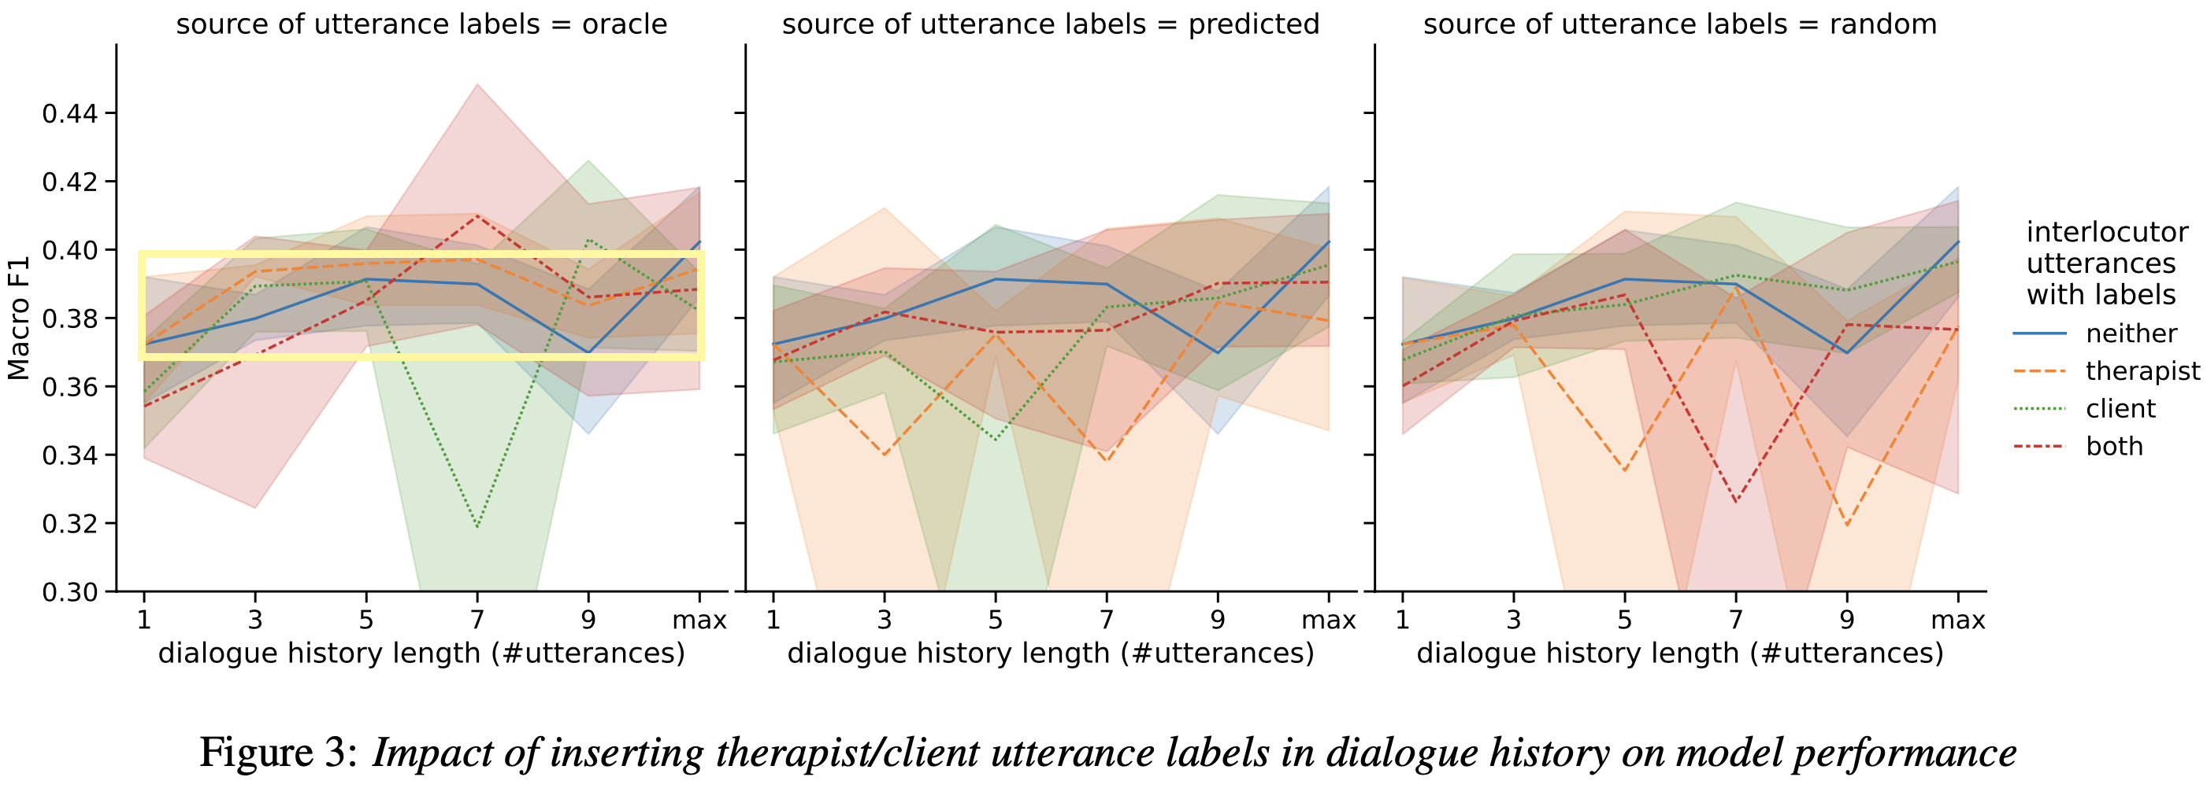
Experiments & Results (pt. 2/3)
Impact of inserting utterance labels in context
Oracle x Therapist Utterance Labels enables marginal performance boost

Slide 24
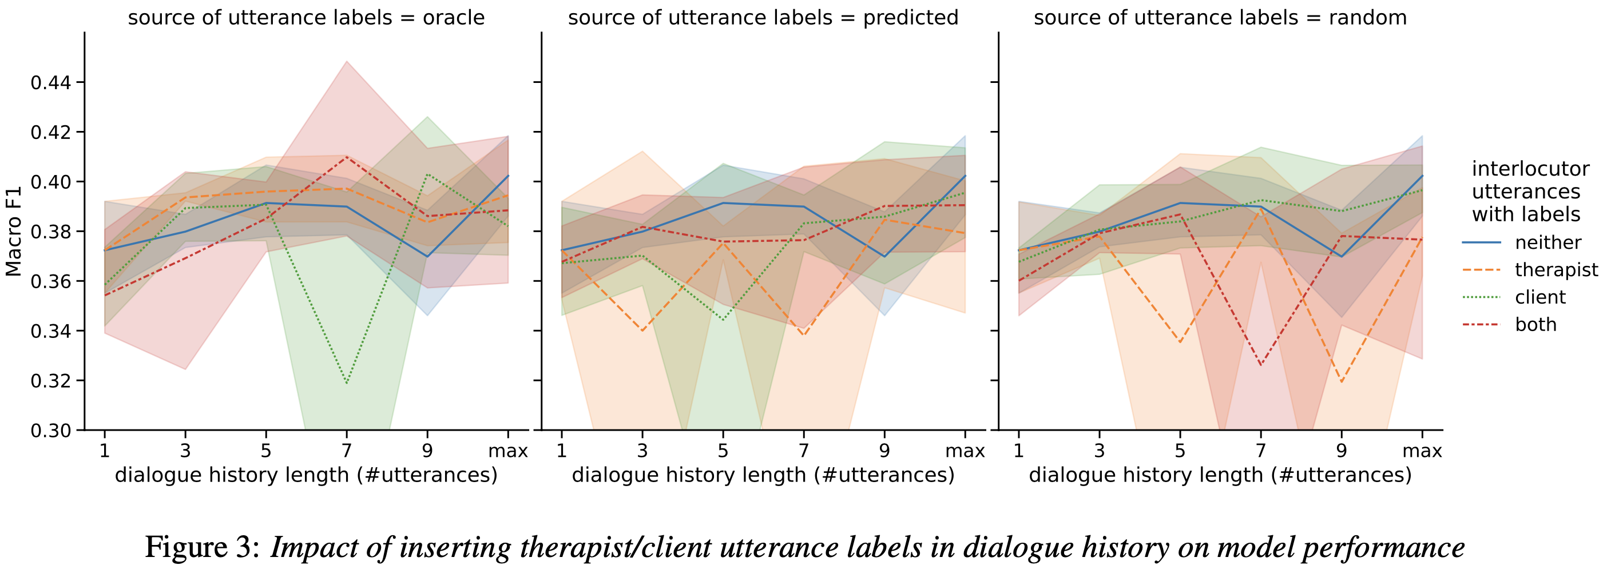
Experiments & Results (pt. 2/3)
Impact of inserting utterance labels in context
Oracle x Therapist Utterance Labels enables marginal performance boost
Other combinations all underperform baseline
Even oracle labels may be noisy, and even more so for predicted & random
Overall performance: oracle > predicted > random, in accordance with utterance label quality.

Slide 25
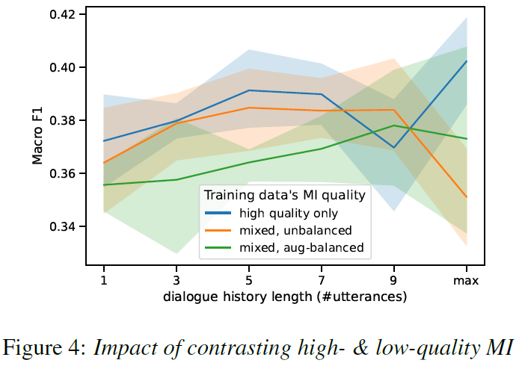
Experiments & Results (pt. 3/3)
Impact of contrasting high- & low-quality MI
Variants of contrast mostly underperform baseline
Possibly: therapist actions in low-quality MI may not adequately represent baseline’s “mistakes”
Hence not effective enough to improve decision boundaries, while introducing more uncertainty into ground truth labels
Aug-Balanced generally has worst performance -> echoing previous finding that neural paraphrasing is harmful.

Slide 26
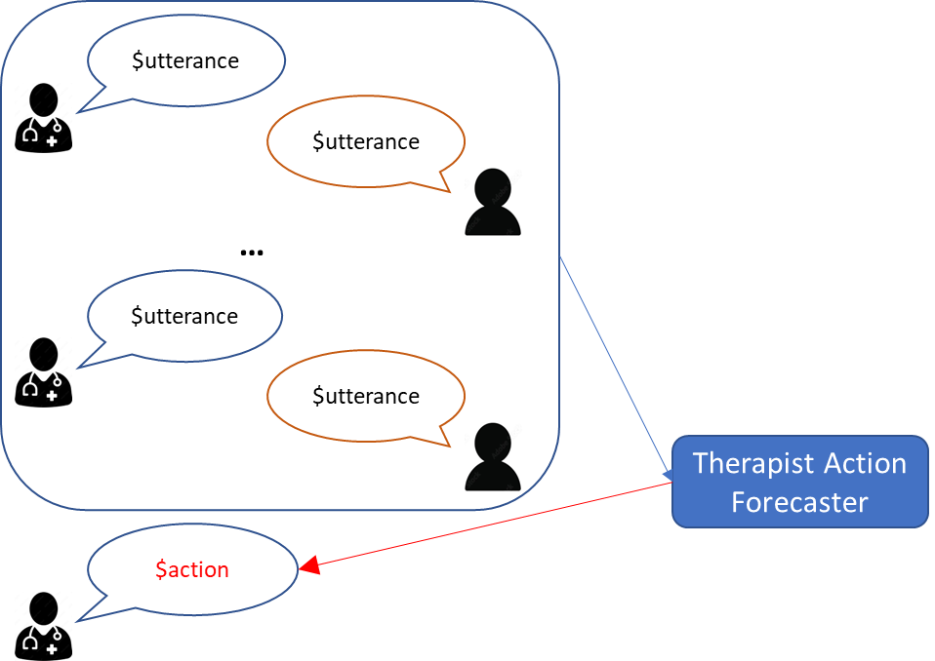
Takeaways:
Probed various modelling choices for therapist action forecasting
Dialogue history length
Data augmentation
Inserting utterance labels into dialogue history
Contrasting high- & low-quality MI
Generally, baseline obtains best performance with mostly negative impact from modelling choices above
No ideal forecaster if only top-1 forecast is used, reflecting therapists’ flexibility in deciding next-turn action
Future work could explore
Probabilistic therapist action forecasting
More effective leveraging of MI quality contrast, e.g.
Suggesting what action should NOT be taken next
Detecting real-time worsening of counselling quality

Slide 27
Part 3/4 Generating next-turn response for therapist &
Its human evaluation
Towards In-Context Non-Expert Evaluation of Reflection Generation for Counselling Conversations (Workshop on Natural Language Generation, Evaluation, and Metrics @ EMNLP 2022)

Slide 28
Human Evaluation for Reflection Generation
Research Question: Are LM-produced reflections coherent & context-consistent? If not, why not?
NLG Task: Generate a reflection, given the N preceding utterances (a.k.a. dialogue history/context)
Application: Reflection training takes time & expert supervision --- good reflection generator can speed it up (Shen et al. 2020)
$utterance
$utterance
…
$utterance
$utterance
Reflection Generator
$reflection

Slide 29
Human Evaluation for Reflection Generation
Research Question: Are LM-produced reflections coherent & context-consistent? If not, why not?
NLG Task: Generate a reflection, given the N preceding utterances (a.k.a. dialogue history/context)
Application: Reflection training takes time & expert supervision --- good reflection generator can speed it up (Shen et al. 2020)
Why only Reflection generation?
Input and Question are proactive, so generation is riskier
Other is mostly just facilitators (e.g., “Hmm”)
In contrast, reflection only requires inferring from context – relatively safer
Why focus on coherence-consistency?
Empirically, we found coherent & context-consistent LM reflections to also be good reflections by MI standards
So, if we filter out semantically erroneous/incongruous reflections, the remaining ones are likely good!

Slide 30
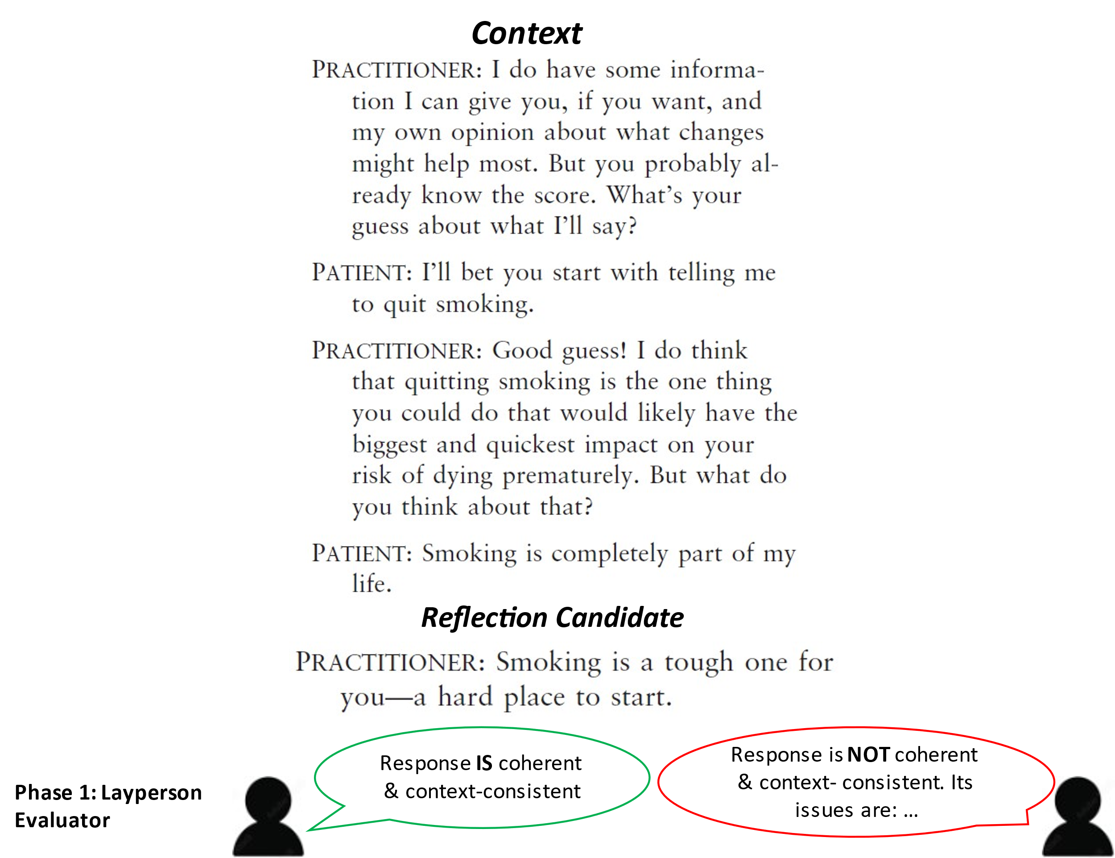
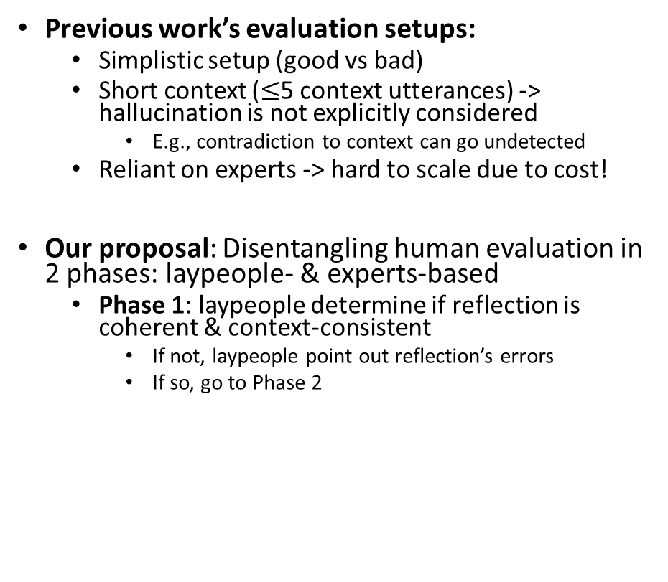
Human Evaluation for Reflection Generation
Previous work’s evaluation setups:
Simplistic setup (good vs bad)
Short context ($≤$5 context utterances) -> hallucination is not explicitly considered
E.g., contradiction to context can go undetected
Reliant on experts -> hard to scale due to cost!
Our proposal: Disentangling human evaluation in 2 phases: laypeople- & experts-based
Phase 1: laypeople determine if reflection is coherent & context-consistent
If not, laypeople point out reflection’s errors
If so, go to Phase 2
Phase 2: experts determine if coherent reflection conforms to therapy guidelines
Motivation: laypeople are qualified for Phase-1 evaluation, thus saving time & resources
In this work, we devise a long-context (14 utterances) annotation scheme for Phase 1

Slide 31
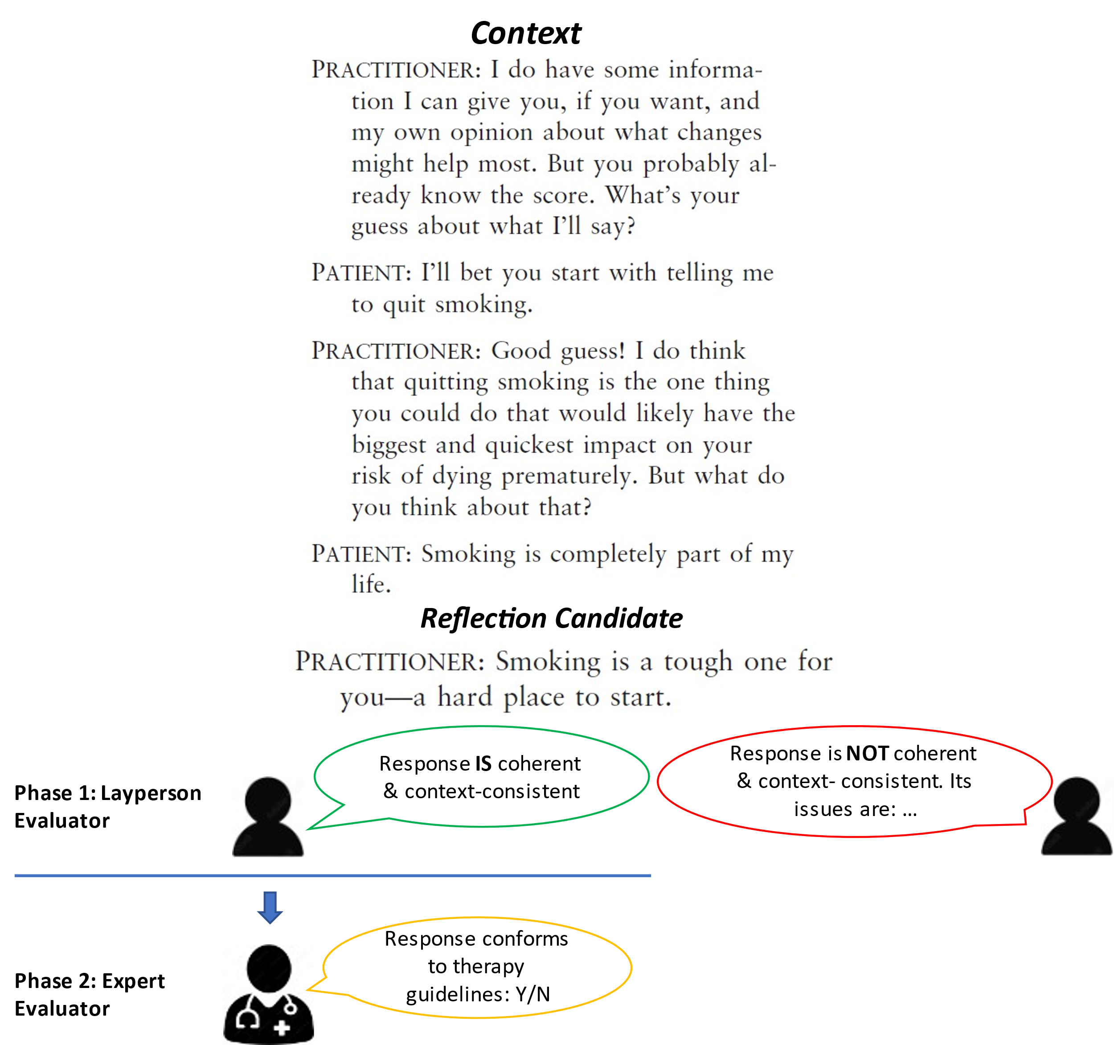
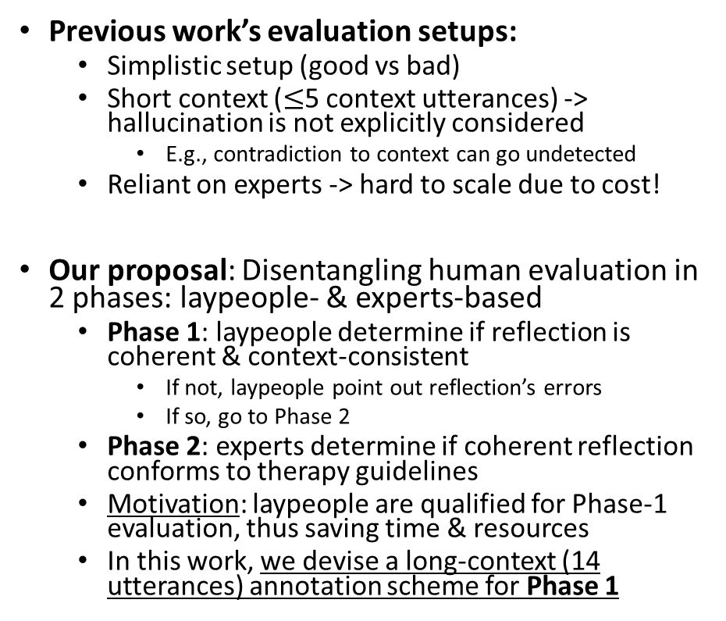
Human Evaluation for Reflection Generation
Previous work’s evaluation setups:
Simplistic setup (good vs bad)
Short context ($≤$5 context utterances) -> hallucination is not explicitly considered
E.g., contradiction to context can go undetected
Reliant on experts -> hard to scale due to cost!
Our proposal: Disentangling human evaluation in 2 phases: laypeople- & experts-based
Phase 1: laypeople determine if reflection is coherent & context-consistent
If not, laypeople point out reflection’s errors
If so, go to Phase 2
Phase 2: experts determine if coherent reflection conforms to therapy guidelines
Motivation: laypeople are qualified for Phase-1 evaluation, thus saving time & resources
In this work, we devise a long-context (14 utterances) annotation scheme for Phase 1

Slide 32
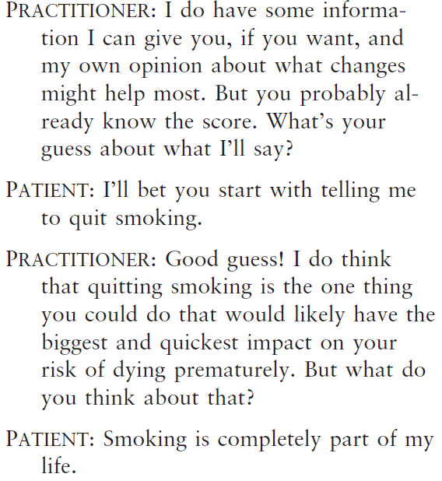
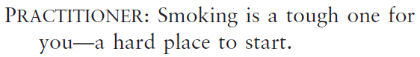
Human Evaluation for Reflection Generation
Reflection Generators: GPT-2 (medium, 355M) & BART (large, 406M)
Fine-tuning: contexts from AnnoMI where gold-standard responses are reflections
Input context: previous utterances left-truncated at 384 tokens in length -> on average most recent 14 utterances
Output: reflection, at most 128 tokens
Decoding:
Greedy
5-Beam
Nucleus, p ∈ {0.4, 0.6, 0.8, 0.95}
Context
Reflection Candidate

Slide 33
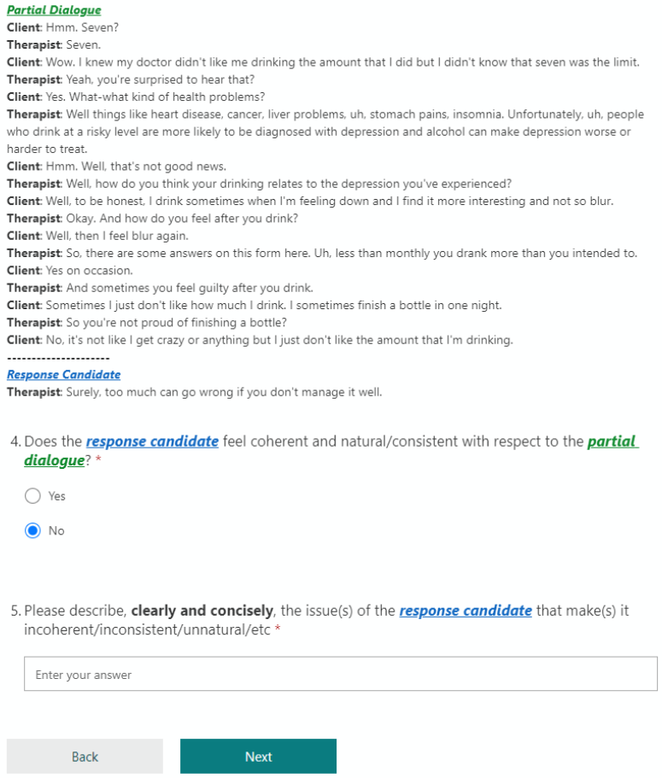
Human Evaluation for Reflection Generation
Annotation Materials
3 contexts from 3 sampled dialogues
60 generated reflections randomly sampled for annotation
Annotators
6 volunteers without prior experience in NLP or psychology/psychotherapy
Each volunteer annotates all 60 reflections
Procedure
No definition of coherence/consistency given
Q1: Is the reflection coherent & consistent w.r.t. its context?
Q2: If not, describe the errors/issues of the reflection

Slide 34
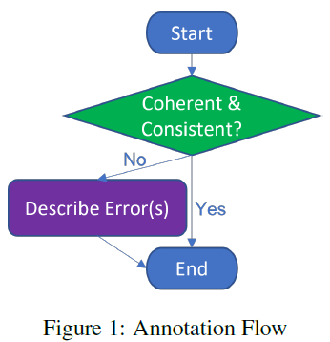
Human Evaluation for Reflection Generation
Annotation Materials
3 contexts from 3 sampled dialogues
60 generated reflections randomly sampled for annotation
Annotators
6 volunteers without prior experience in NLP or psychology/psychotherapy
Each volunteer annotates all 60 reflections
Procedure
No definition of coherence/consistency given to avoid bias
Q1: Is the reflection coherent & consistent w.r.t. its context?
Q2: If not, describe the errors/issues of the reflection

Slide 35
Results
Inter-Annotator Agreement
Moderate on “Coherent & Consistent?” Question (Randolph’s kappa)
Processing of Annotators’ Error Descriptions: Thematic Analysis
Manually and systematically identifying common patterns in free-text error descriptions
Summarising patterns into discrete error categories

Slide 36
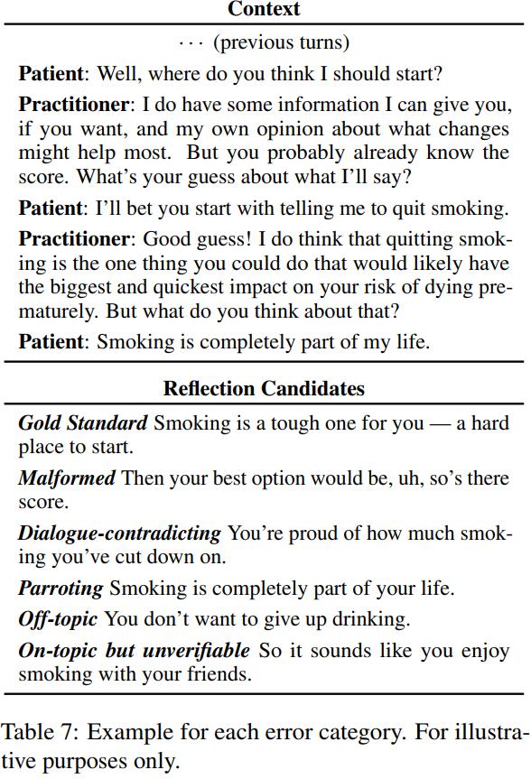
Results
Established Error Categories
(examples are for illustrative purposes only)
Malformed
A response that “feels broken” due to unclear references, bad grammar, or confusing logic
Dialogue-contradicting
Contradicting context partially or fully
Parroting
Unnaturally repeating a certain part of context
Off-topic
Little to no relevance to dialogue
On-topic but unverifiable w.r.t. Context
Considerations
Good reflections can sometimes repeat what client has said, but they are different from parroting
Dialogue-contradicting, Off-topic & On-topic but unverifiable are sub-types of hallucination
Users of this scheme may add “Other” to capture errors that do not fit neatly into one category

Slide 37
Results
Established Error Categories
(examples are for illustrative purposes only)
Malformed
A response that “feels broken” due to unclear references, bad grammar, or confusing logic
Dialogue-contradicting
Contradicting context partially or fully
Parroting
Unnaturally repeating a certain part of context
Off-topic
Little to no relevance to dialogue
On-topic but unverifiable w.r.t. Context
Considerations
Good reflections can sometimes repeat what client has said, but they are different from parroting
Dialogue-contradicting, Off-topic & On-topic but unverifiable are sub-types of hallucination
Users of this scheme may add “Other” to capture errors that do not fit neatly into one category

Slide 38
Results
Established Error Categories
(examples are for illustrative purposes only)
Malformed
A response that “feels broken” due to unclear references, bad grammar, or confusing logic
Dialogue-contradicting
Contradicting context partially or fully
Parroting
Unnaturally repeating a certain part of context
Off-topic
Little to no relevance to dialogue
On-topic but unverifiable w.r.t. Context
Considerations
Good reflections can sometimes repeat what client has said, but they are different from parroting
Dialogue-contradicting, Off-topic & On-topic but unverifiable are sub-types of hallucination
Users of this scheme may add “Other” to capture errors that do not fit neatly into one category

Slide 39
Results
Established Error Categories
(examples are for illustrative purposes only)
Malformed
A response that “feels broken” due to unclear references, bad grammar, or confusing logic
Dialogue-contradicting
Contradicting context partially or fully
Parroting
Unnaturally repeating a certain part of context
Off-topic
Little to no relevance to dialogue
On-topic but unverifiable w.r.t. Context
Considerations
Good reflections can sometimes repeat what client has said, but they are different from parroting
Dialogue-contradicting, Off-topic & On-topic but unverifiable are sub-types of hallucination
Users of this scheme may add “Other” to capture errors that do not fit neatly into one category

Slide 40
Results
Established Error Categories
(examples are for illustrative purposes only)
Malformed
A response that “feels broken” due to unclear references, bad grammar, or confusing logic
Dialogue-contradicting
Contradicting context partially or fully
Parroting
Unnaturally repeating a certain part of context
Off-topic
Little to no relevance to dialogue
On-topic but unverifiable w.r.t. Context
Considerations
Good reflections can sometimes repeat what client has said, but they are different from parroting
Dialogue-contradicting, Off-topic & On-topic but unverifiable are sub-types of hallucination
Users of this scheme may add “Other” to capture errors that do not fit neatly into one category

Slide 41
Results
Established Error Categories
(examples are for illustrative purposes only)
Malformed
A response that “feels broken” due to unclear references, bad grammar, or confusing logic
Dialogue-contradicting
Contradicting context partially or fully
Parroting
Unnaturally repeating a certain part of context
Off-topic
Little to no relevance to dialogue
On-topic but unverifiable w.r.t. Context
Considerations
Dialogue-contradicting, Off-topic & On-topic but unverifiable are sub-types of hallucination
Users of this scheme may add “Other” to capture errors that do not fit neatly into one category

Slide 42
Takeaways
Proposed laypeople-based evaluation setup of machine-generated reflections for counselling dialogues w.r.t coherence/consistency
Disentangled from expert evaluation w.r.t. conformity to therapy guidelines, thus saving time & resources on evaluation
Established error categories for laypeople-based evaluation
Based on thematic analysis on free-text error descriptions from non-experts about generated reflections
Future Work
Compare experts’ and laypeople’s evaluations and see whether they agree, esp. w.r.t. reflections generated by larger LMs like GPT-3 (under review)
Human evaluation of other quality aspects, like safety (work in progress)

Slide 43
Part 4/4 Outlook: How large language models (LLMs)
can be conducive to NLP-based real-time assistance

Slide 44

How can we leverage LLMs?
Photo: https://stock.adobe.com/
Data Augmentation
Application: helps to create paraphrased version of sensitive datasets & train smaller offline LMs as response generator/retriever
Caveat: LLM shouldn’t have too much freedom --- it’s not a therapist or a client!

Slide 45
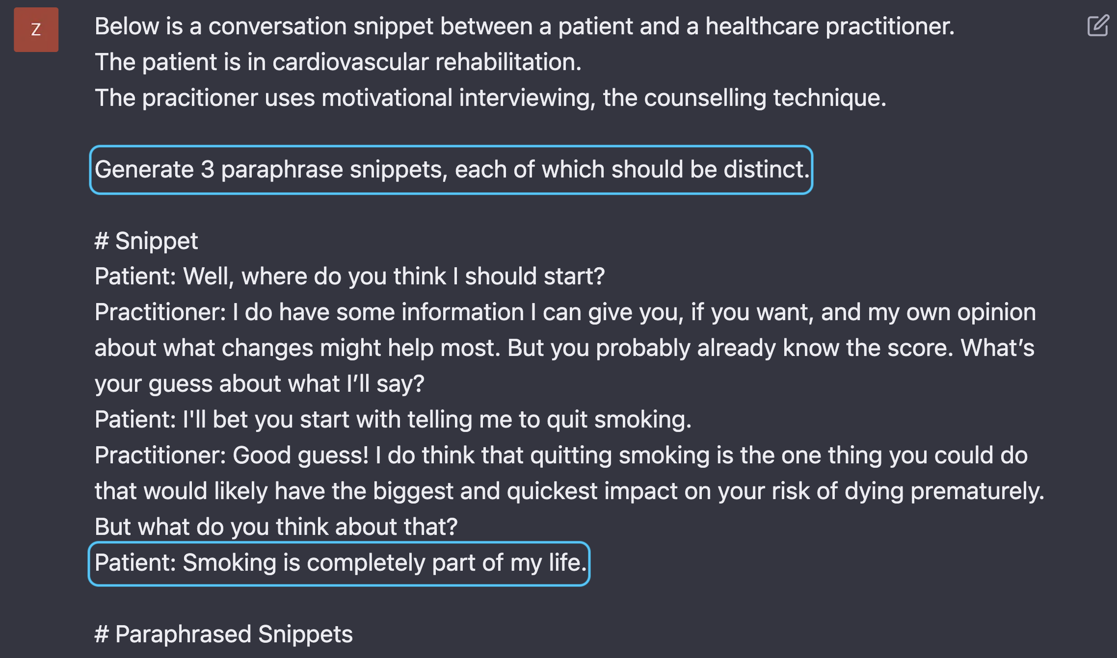
Data Augmentation

Slide 46
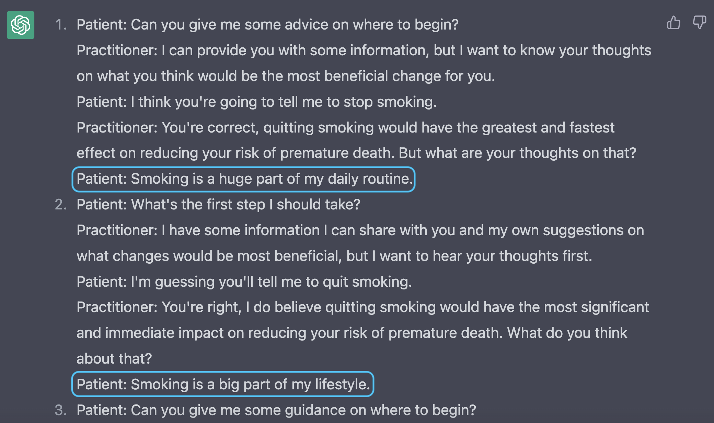
Data Augmentation

Slide 47
How can we leverage LLMs?
Photo: https://stock.adobe.com/
Response (e.g. reflection) Suggestion
Application: providing response candidates for human therapist to choose from
Caveat: filtering mechanism needs to be in place to remove responses that are incoherent/inconsistent or violate counselling principles

Slide 48
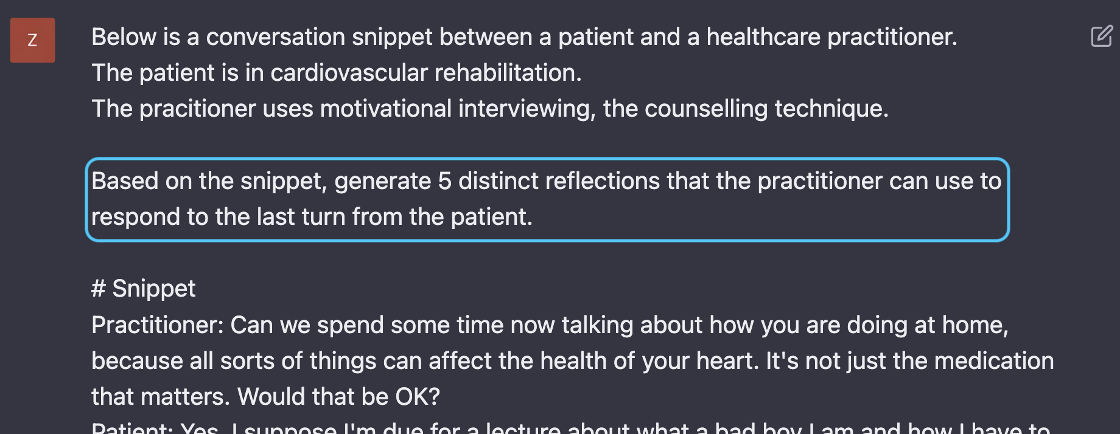
Reflection Suggestion

Slide 49
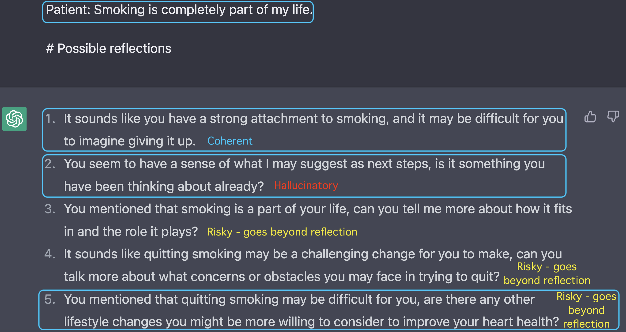
Reflection Suggestion

Slide 50
Reflection Suggestion
Photo: https://stock.adobe.com/
LLMs are fluent but hallucination still exists -> Filtering needed
A dataset of negative (incoherent/inconsistent) examples can be used to train a model to filter out hallucinatory outputs.
LLMs can go beyond reflection and start trying to influence the dialogue flow -> Filtering may be needed
To achieve true real-time suggestion, accurate voice-to-text is needed to obtain faithful transcripts to prompt LLM

Slide 51
How can we leverage LLMs?
Photo: https://stock.adobe.com/
Numerous other possibilities …

Slide 52
Today’s Journey
Creating the first publicly available & expert-annotated MI Dataset: AnnoMI
Suggesting next-turn MI dialogue action for therapist
Suboptimal performance, so we switched gears!
Generating reflections for therapist in live counselling
Annotation scheme contributes towards filtering mechanism for LM-generated reflections
LLMs are exciting!
Versatile paraphraser
Promising response generator, but needs filtering
…

Slide 53
References
Rollnick, S., Miller, W. R., Butler, C. C., & Aloia, M. S. (2008). Motivational interviewing in health care: helping patients change behavior.
Pérez-Rosas, V., Wu, X., Resnicow, K., & Mihalcea, R. (2019, July). What makes a good counselor? learning to distinguish between high-quality and low-quality counseling conversations. In Proceedings of the 57th Annual Meeting of the Association for Computational Linguistics (pp. 926-935).
Cao, J., Tanana, M., Imel, Z., Poitras, E., Atkins, D., & Srikumar, V. (2019, July). Observing Dialogue in Therapy: Categorizing and Forecasting Behavioral Codes. In Proceedings of the 57th Annual Meeting of the Association for Computational Linguistics (pp. 5599-5611).
Shen, S., Welch, C., Mihalcea, R., & Pérez-Rosas, V. (2020, July). Counseling-style reflection generation using generative pretrained transformers with augmented context. In Proceedings of the 21th Annual Meeting of the Special Interest Group on Discourse and Dialogue (pp. 10-20).

Slide 54

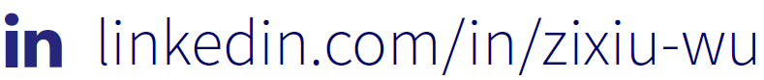
Thank you!
Zixiu “Alex” Wu

Slide 55
Thank you!

